Slide 1
Programming Fundamentals
by Abeeha Sattar

Slide 2
Nested Loops
It’s loops but… Nested… o:
So, how does it work?
Consider this:
for(int i = 0; i < 5; i++) {
printf("Outer loop! Iteration # %d:\n", i);
for (int j = 0; j < 5; j++) {
printf("\tInner loop! Iteration # %d\n", j);
}
}

Slide 3
Remember one of your practice problems?
Sorting by ascending or descending order.
You need nested loops to solve that problem!
Let’s first discuss the logic and then try it out!
Have a look at this cool visualizer!
https://www.hackerearth.com/practice/algorithms/sorting/bubble-sort/visualize/

Slide 4
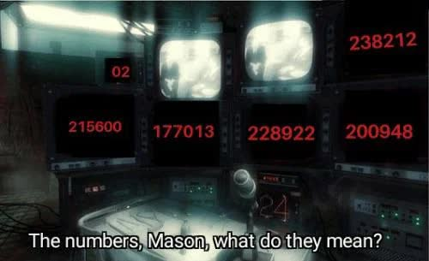
Stars… Patterns… The numbers…
For all the following, prompt user for input for lengths etc.:
Draw a right-angle triangle using asterisks on your console.
Draw an isosceles triangle using asterisks on your console.
Draw a diamond (ask the user how many lines the diamond should take – should be an odd number and greater than or equal to 3)
Modify the diamond so that each line prints the line number instead of stars. (it’s pretty easy)

Slide 5
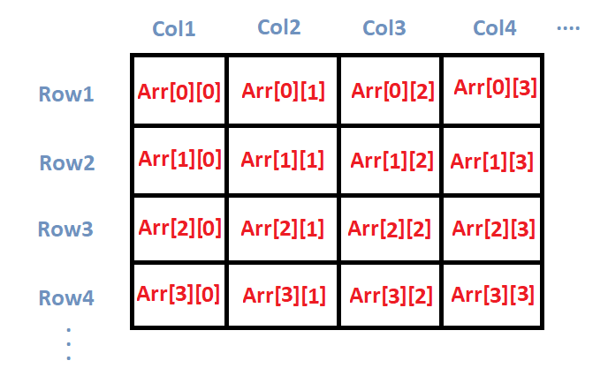
2-D Arrays
Think of matrices that you did in your math classes!

Slide 6
So, how do we do it in code?
For one dimensional arrays, we used one pair of square brackets.
For two dimensional, we will use two pairs! Like so…
int array[10][10];
This will make a 10x10 array.
The first one is number of rows, and the second one is the number of columns.

Slide 7
Accessing Elements
Can access the indices individually by using their index numbers:
Array[0][0] – will get us the value at 0 row 0 column
Array[1][4] – will get us the value at 1 row 4 column
Like with 1D arrays, we can use loops to iterate through a 2D array. However, now we need nested loops!
Usually:
Outer loop handles the rows
Inner loop handles the columns

Slide 8
Let’s have a look!
for(int i = 0; i < 5; i++) {
for (int j = 0; j < 5; j++) {
printf("%d ", array[i][j]);
}
printf(“\n");
}

Slide 9
Try and Solving these yourself before looking at the solution :D
https://www.geeksforgeeks.org/dsa/problem-solving-arrays/
https://www.w3resource.com/c-programming-exercises/array/index.php
https://www.programiz.com/c-programming/examples/add-matrix
See on the left-hand side for more examples
https://www.includehelp.com/c-programs/c-programs-two-dimensional-array-or-matrix-programs.aspx

Slide 10
Fin~

